Slide 1
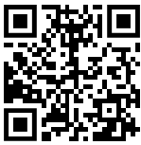

For the Love of Chemistry: G.P.S. Guidance for Motivating Students
chemistryconnected.com
Laurie S. Starkey
Cal Poly Pomona
lsstarkey@cpp.edu
Wiley Webinar
Bitmoji

Slide 2
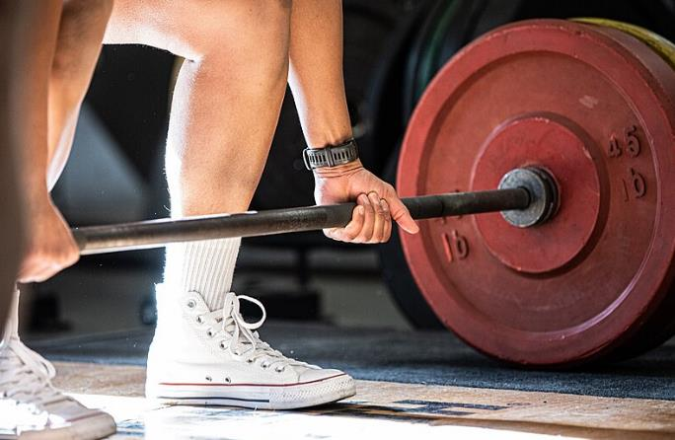
Why is Motivation Needed?
Because
all growth involves discomfort
To be successful, students must:
Put in the required hours every day/week
Keep working on challenging problems
Persist after facing setback(s)

Slide 3
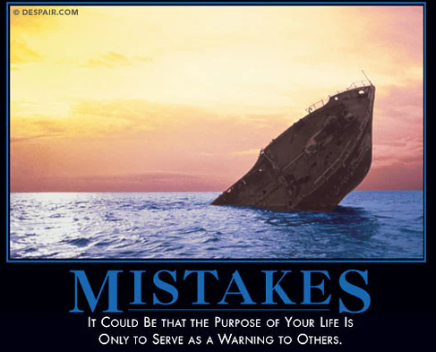
What Motivates Students?
We can do better than the Fear of Failure…

Slide 4
Keeping Students Motivated (G.P.S.)
Motivating Learners Course by Motivate Lab*
Growth Mindset
Purpose & Relevance
Sense of Belonging
*Dustin Thoman
dthoman@sdsu.edu

Slide 5


GPS: Encouraging a Growth Mindset
Fixed Mindset
Growth Mindset
You can learn new things, but you can’t
really change how intelligent you are.
strongly disagree disagree agree strongly agree
Only people with a natural talent will be truly
good at sports – you have to be “born with it.”
strongly disagree disagree agree strongly agree
https://commons.wikimedia.org/wiki/File:Fixed_versus_growth_mindset.png

Slide 6
GPS: Encouraging a Growth Mindset
Fixed Mindset
Growth Mindset
Can’t change ability or intelligence
Abilities are malleable & can be developed
Smart people don’t have to work hard
Effort leads to improvement
Setback = give up
Setback = try new strategies (resilience)
Avoids challenges
Embraces challenges
https://commons.wikimedia.org/wiki/File:Fixed_versus_growth_mindset.png

Slide 7
GPS: Encouraging a Growth Mindset
Don’t praise ability – focus on process
Using effective strategies
Making an effort
Challenging yourself
GROWTH
Persisting through difficulty
Seeking support & feedback
Learning from mistakes

Slide 8
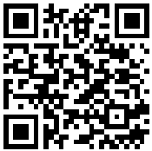
GPS: Encouraging a Growth Mindset
Value formative assessment
    points for textbook problems!
    access to detailed solutions
    low-stakes online homework
Drop lowest exam, revise/retest/regrade
Discuss study strategies, reading guides
Discuss neuroplasticity, etc.
Share your own stories (struggles/growth)
Provide metacognitive activities
resources

Slide 9
Fostering Metacognitive Reflection
Exam Wrappers
  Survey given after each midterm exam
  Students reflect on…
    how they prepared
    what mistakes they made
    how they will prepare differently next time
  Course credit earned by submitting
  wrapper + exam corrections (4 points each)

Slide 10
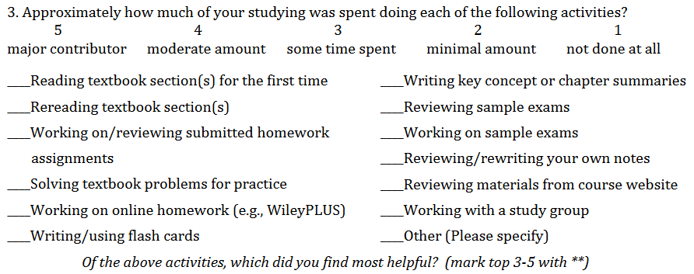
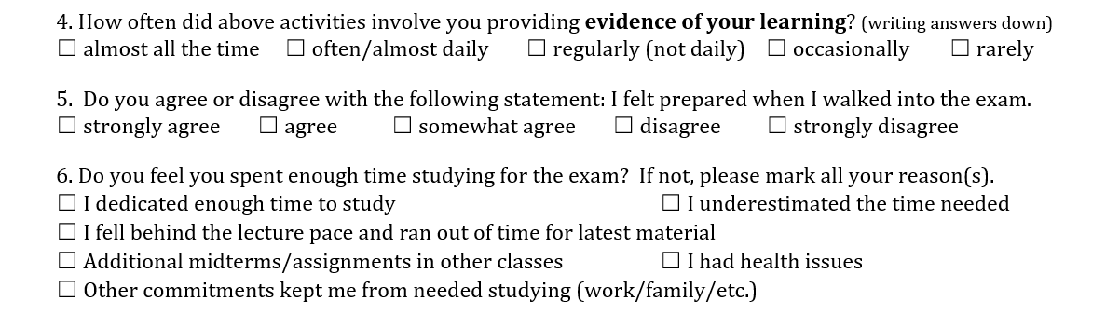
Metacognitive Reflection: Exam Wrapper

Slide 11
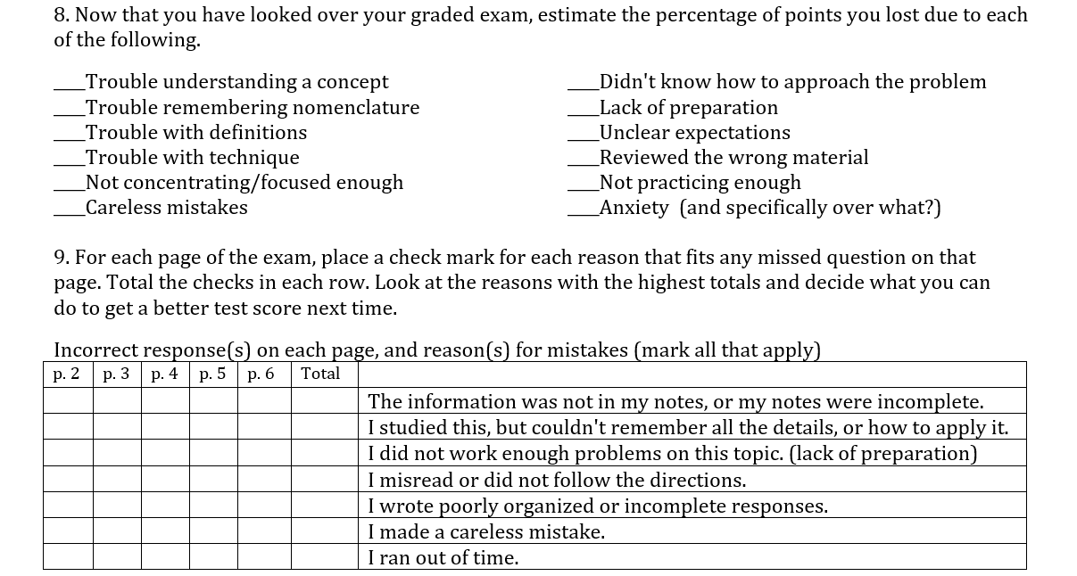
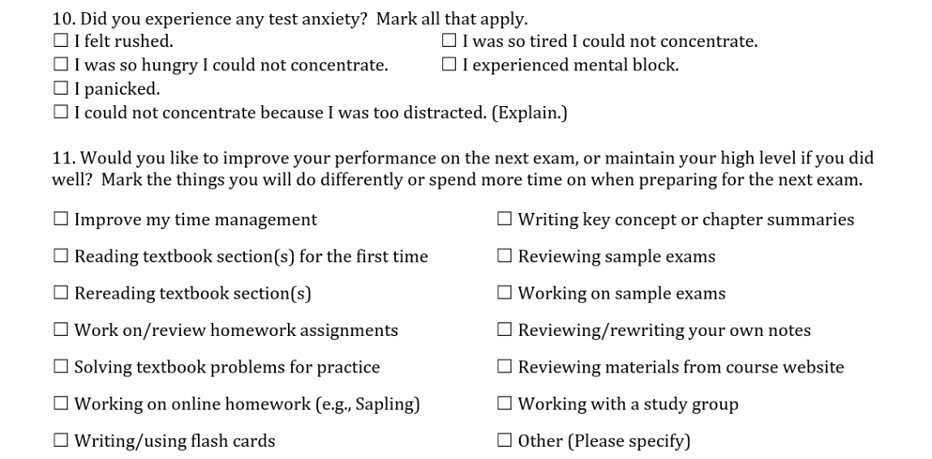
Metacognitive Reflection: Exam Wrapper

Slide 12
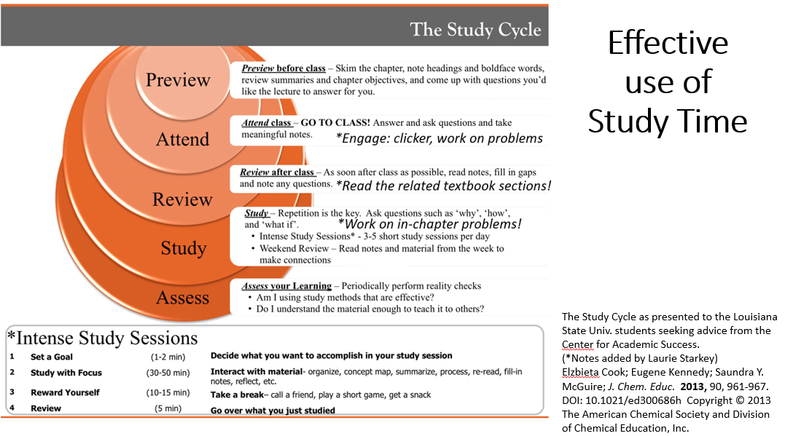
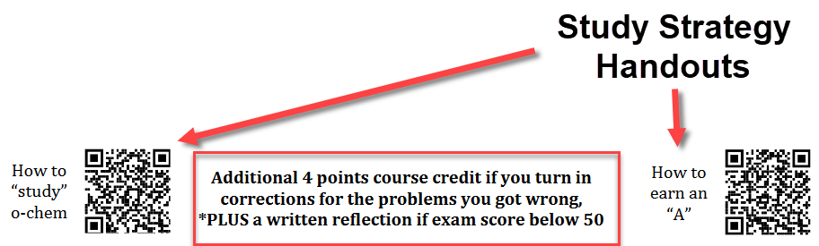
Metacognitive Reflection: Exam Wrapper

Slide 13
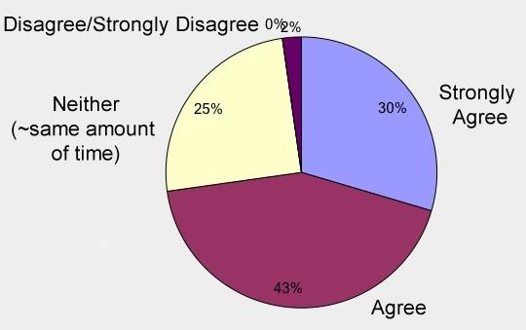
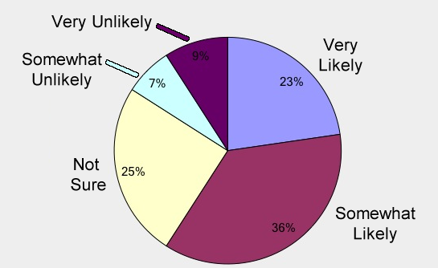
Exam Wrapper – Student Feedback
Spent more time reviewing
graded midterm?
Improved grade
on second midterm?

Slide 14
GPS: Focusing on Purpose and Relevance
#1 Motivator! Leads to persistence, deeper learning.
Connected to a bigger purpose
Relevant to my life
Something
I value
Why am I doing this?
Medicine
Green Chem.
Sustainability
Useful to me & my goals, major, career
Meaningful, makes a difference

Slide 15
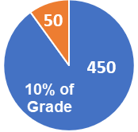
Weekly “Friday Five”
Reflection
1) Describe how you spent your time working on
Organic Chemistry this past week.
2) Describe your plan for working on Organic
Chemistry this coming week.
3) A 3rd writing prompt promotes G.P.S.
…and it’s a wonderful way to connect!

Slide 16
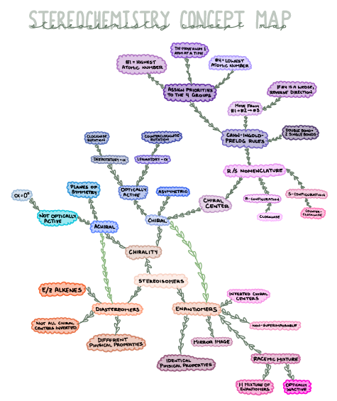
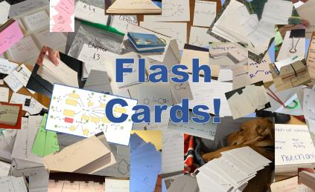
Friday5 Prompts (Gradescope)
Create a Concept Map
Research/share Nanotech topic
Start-Stop-Continue
(mid-semester feedback)
Mental Health check-in
Career planning (explore REU)
ACS celebrates Earth Day
Celebrate National Chemistry Week (explore webpage)
Upload a picture of your flash cards
Favorite volunteer activities?
Who inspires you?

Slide 17
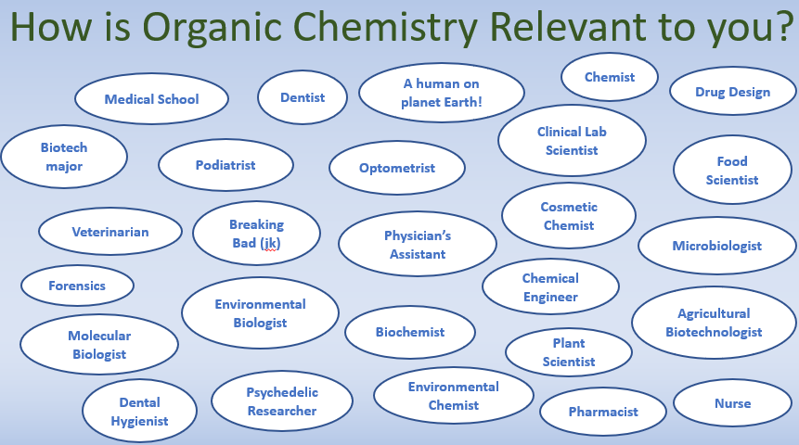
Friday5 Responses → Class “411” Announcements
17

Slide 18
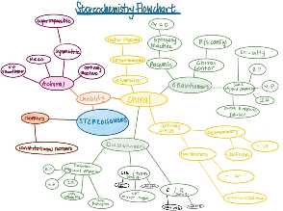
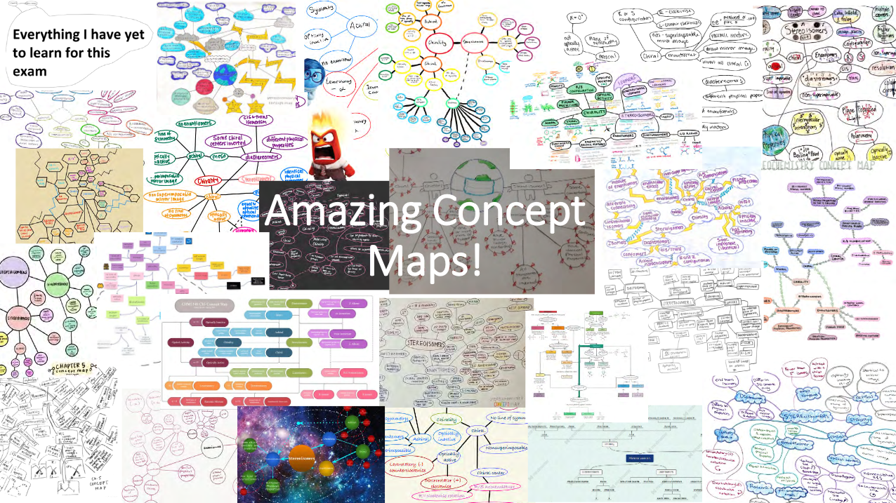
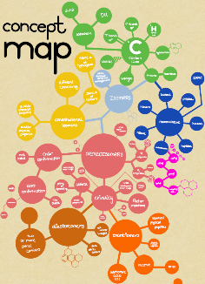
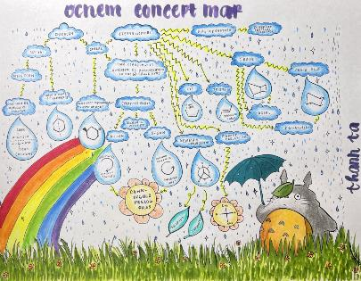
Friday5 Responses → Class “411” Announcements
Last Year’s
Stereoisomer Concept Map Winner! ($20 gift card)
18

Slide 19
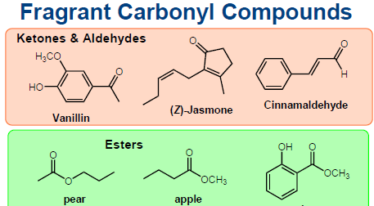
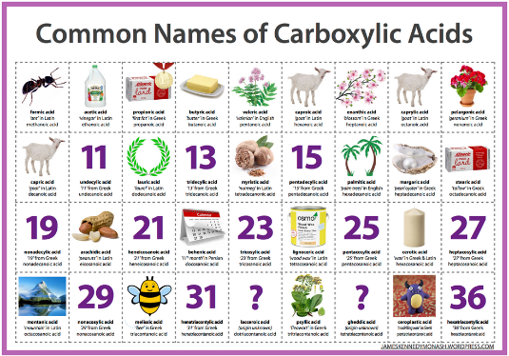
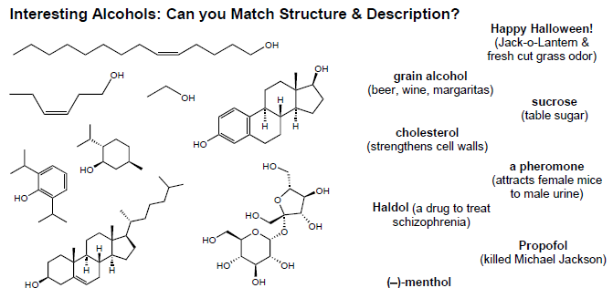
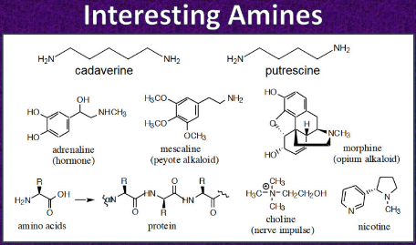
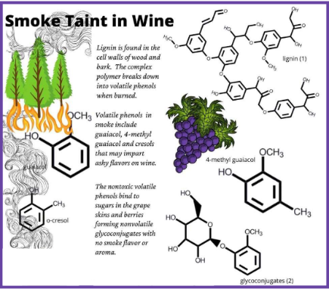
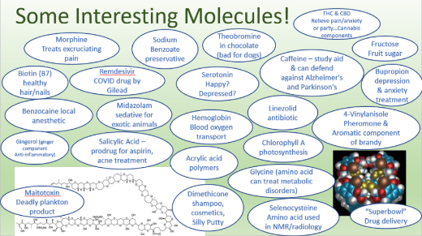
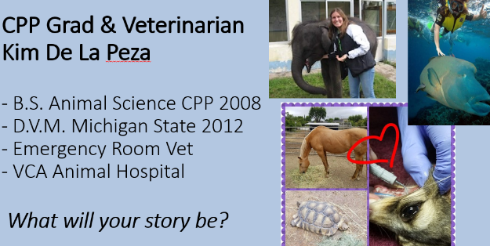
GPS: Focusing on Purpose and Relevance
Weekly reflection assignments
  Find/share an interesting molecule
  Tell me why this course matters to you
Share stories of former students
Provide “hooks” to grab attention

Slide 20
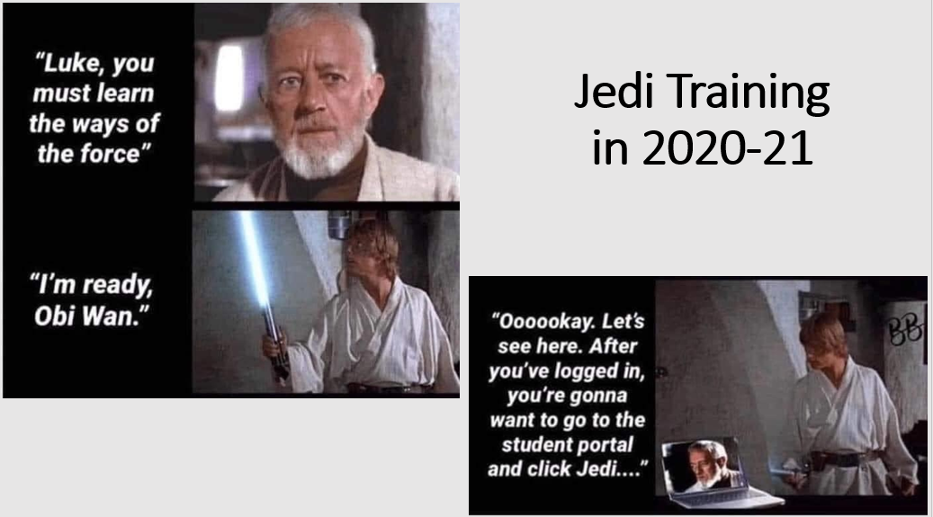
GPS: Build Community, Sense of Belonging

Slide 21
GPS: Build Community, Sense of Belonging
Support learning by building relationships
Promote a Sense of Belonging
Do I belong in this class?
Am I the only one who is confused?
Students who are included are open to critical feedback, can accept challenges & bounce back
Critical for 1st generation (help close achievement gap?)
Teacher
Student
CHEMISTRY
Student

Slide 22
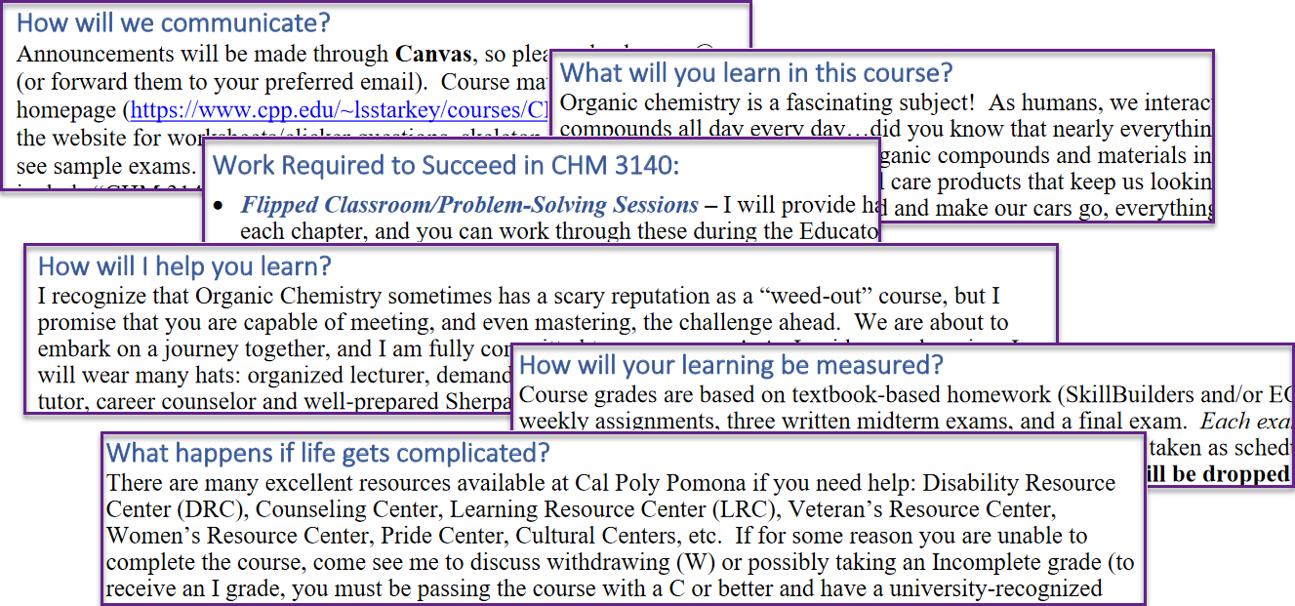
GPS: Build Community, Sense of Belonging
  Redesigned syllabus
  Student-centered, you/I/we
Welcome to Organic Chemistry!

Slide 23
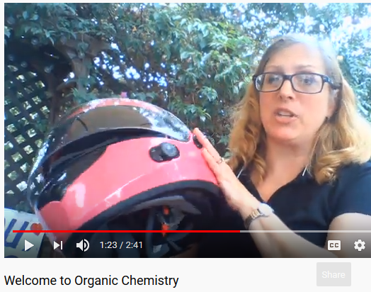
GPS: Build Community, Sense of Belonging
Introduction video
  Introduce yourself, share your passion,
  Provide supportive messaging…
  it’s okay to be nervous; I look forward
  to working with you; you got this!
  Course Padlet
  Students can introduce themselves
  Encourage study groups
  Organic Learning Community (OLC)
  Offer credit for weekly report w/selfie pic Student testimonials
Welcome to Organic Chemistry!

Slide 24
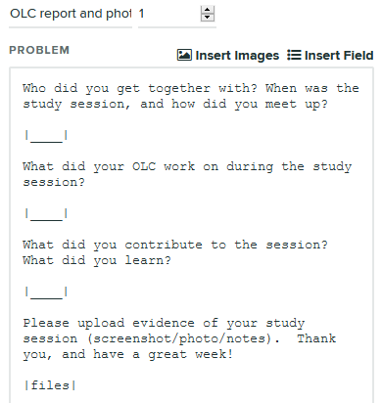
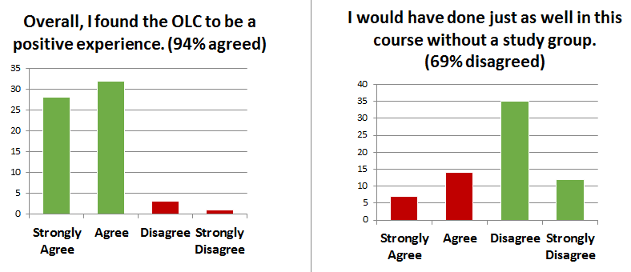
GPS: Build Community, Sense of Belonging
OLC Reporting (Gradescope Online Assignment)

Slide 25
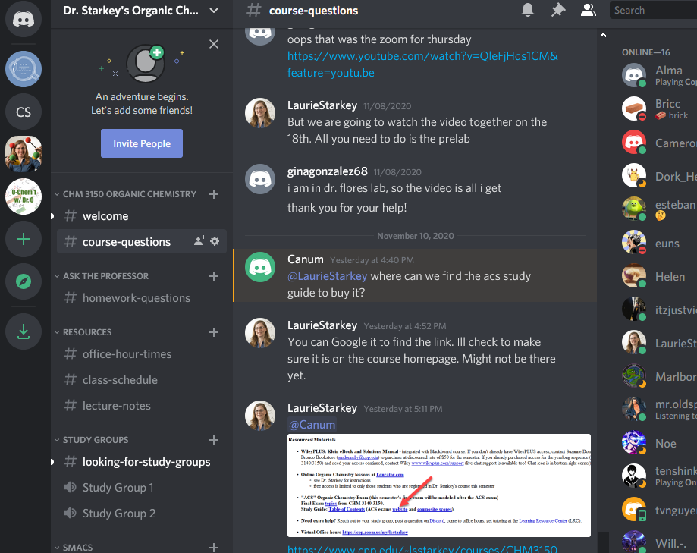

GPS: Build Community, Sense of Belonging
Fostering Communication
  Discussion boards
  Google Voice (texting)
  Discord server
    instructor/student Q&A posts
    student/student
    Familiar to gamers
https://discord.gg/m6gQWE
25

Slide 26
I’m Motivationally Curious…where do I go from here?
Consider Motivate Lab* training
Growth Mindset
Purpose & Relevance
Sense of Belonging
*Dustin Thoman
dthoman@sdsu.edu
Re: Motivating Learners Course
Infuse G.P.S. messaging in all interactions with students (lecture, office hours, email…)
Get students talking to each other!
Provide supportive resources – can motivational G.P.S. be infused throughout a textbook?
Notes:
CJW
Future Co-Author (5th Edition)
lsstarkey@cpp.edu

Slide 27
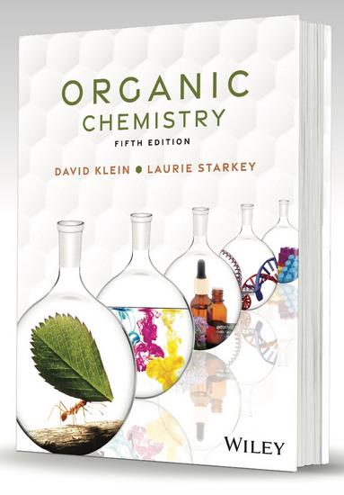
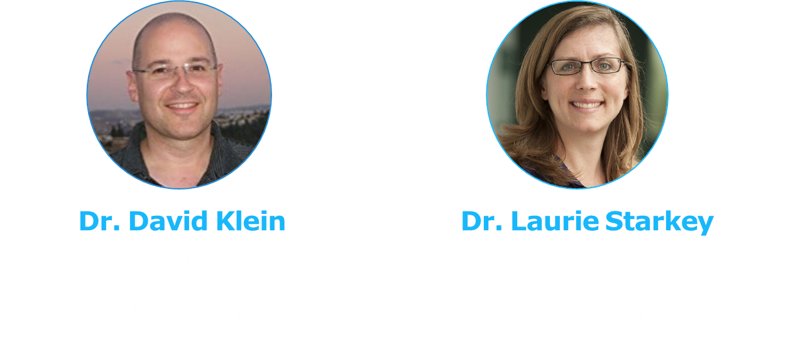
Can Motivational G.P.S.
be infused throughout
a textbook? I think so!
Klein-Starkey 5th Ed.
Notes:
CJW
Future Co-Author (5th Edition)
lsstarkey@cpp.edu

Slide 28
What’s new in Klein-Starkey textbook?
Revisions based on faculty feedback
Revisions based on teaching experience
Revisions to increase student engagement & motivation
  Reorganized content (logical, clear, efficient)
  New SkillBuilders, problem-solving strategies
  Study tips, hints, common mistakes
  New applications and 400+ new graphics/images
  (Purpose, Relevance, Sense of Belonging)

Slide 29
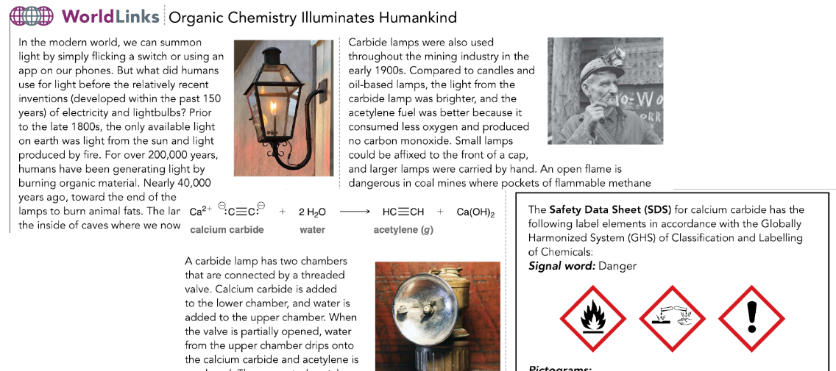
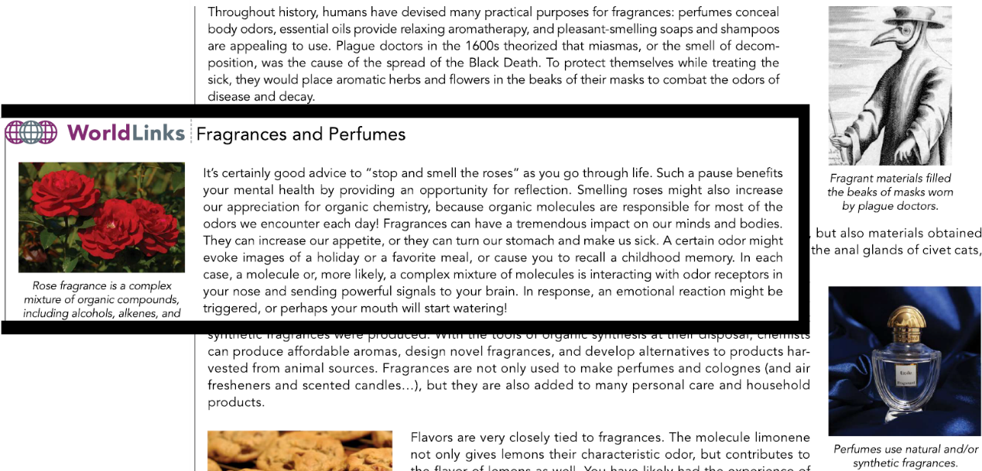
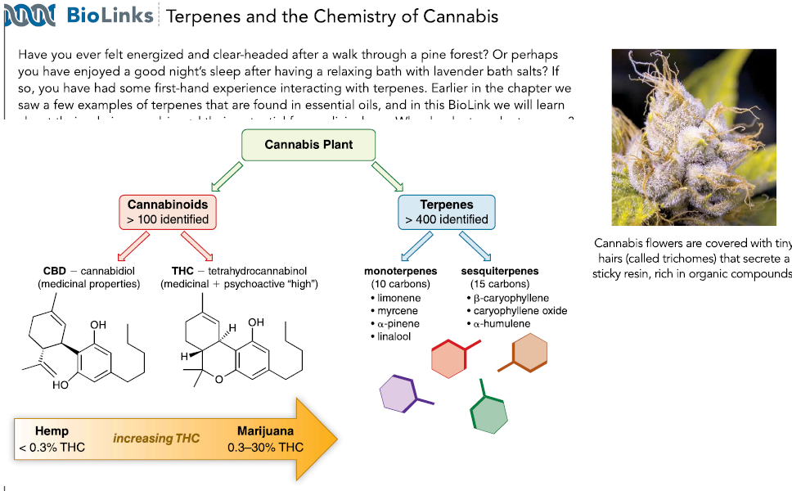
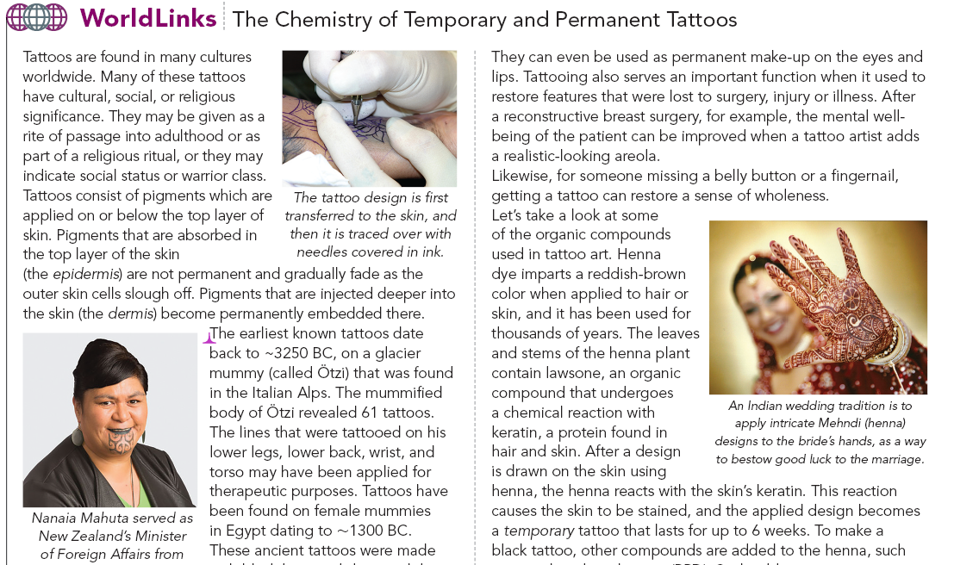
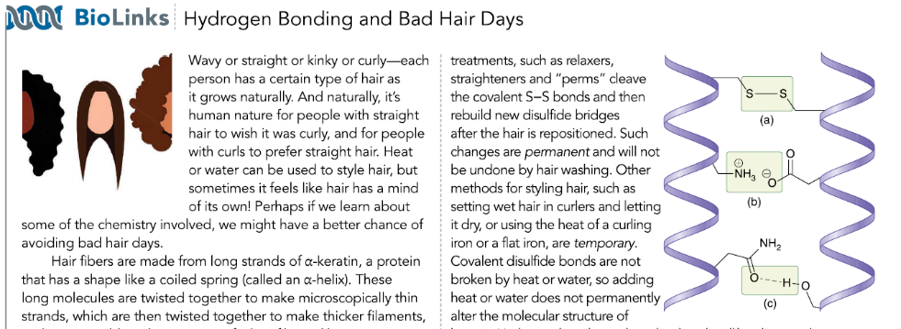
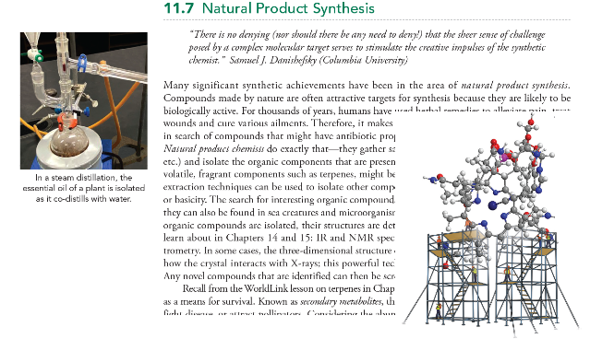
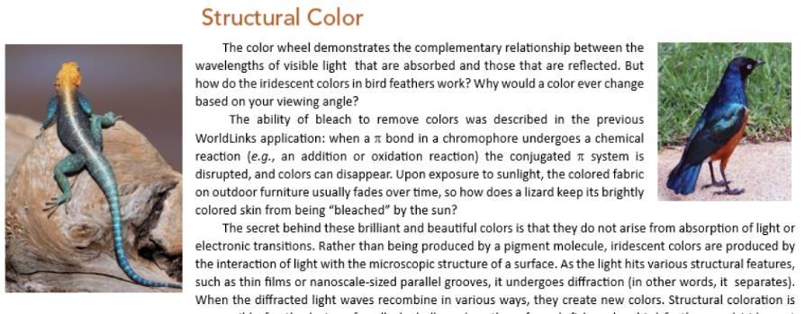
New WorldLink/BioLink Applications

Slide 30
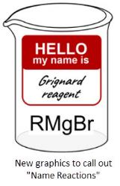

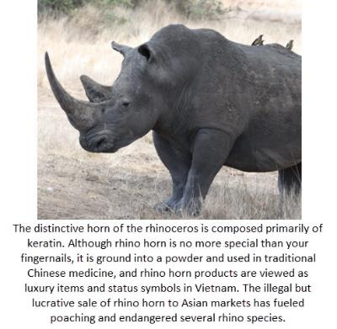
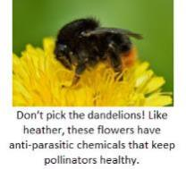
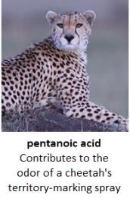
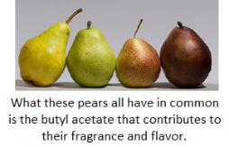
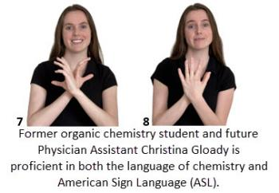
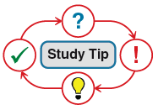
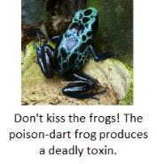






















Fear of Failure For the Love of Chemistry…
Accessible Interesting Inclusive

