Slide 1
Technology-Infused Teaching: Better, Stronger, Faster
Laurie S. Starkey
Cal Poly Pomona
Dept. of Chemistry & Biochemistry

Slide 2
When/How does the best learning occur?
Well-organized professor
Engaging lecture presentation
Variety of teaching methods employed
makes material accessible
keeps students active and focused
audio, visual, hands-on
Well-defined learning outcomes and clear expectations
Professor cares about student’s learning
Abundant and timely feedback provided
know what the goal is and how to achieve it
Should this matter? Why does it?
assessment, keep on track, improve
Affective Domain
Student has interest in subject matter
Reasonable work/academic schedule
Student is healthy: sleep/diet/exercise
easier to make the needed commitment
time available to dedicate to class work
receptive mind/body

Slide 3
I’m not afraid of the Big, Bad MOOCs
RELATIONSHIPS
CONTENT
Deep, Sustained Learning
involves human contact!
Teacher
Student
www.printactivities.com
Information Dissemination
≠ Teaching & Learning
Subject

Slide 4
How can use of TECHNOLOGY promote learning?
Well-organized professor
Engaging lecture presentation
Variety of teaching methods employed
makes material accessible
keeps students active and focused
audio, visual, hands-on
Well-defined learning outcomes and clear expectations
Professor cares about student’s learning
Abundant and timely feedback provided
know what the goal is and how to achieve it
Should this matter? Why does it?
assessment, keep on track, improve
Affective Domain
Student has interest in subject matter
Reasonable work/academic schedule
Student is healthy: sleep/diet/exercise
easier to make the needed commitment
time available to dedicate to class work
receptive mind/body

Slide 5
Philosophy: I don't use technology for the sake of technology.
PowerPoint presentations can be boring and passive (forgive me for today's talk!)
I am skeptical of any new fad

Slide 6
Lab Preparation
Online Quizzes (WebCT, Blackboard): instant feedback, assessment
Online Tutorials (Adobe Presenter, SoTL FLC, eLearning Flash animation, Mediavision filming) http://www.csupomona.edu/~lsstarkey/ochemlab over 25,000 visitors from all over the world since 2008
Benefits: unlimited time, asynchronous, reviewable, available in the future

Slide 7
Prelab Quiz: Overall Score
Sp 07: 29 students watched entire video; 7 watched some
Mean = 30/65
Mean = 50/65

Slide 8
Prelab Quiz: Apparatus Sketch
Percent of Students at each Score (Max Score = 10 points)

Slide 9
Prelab Survey: Confidence in Running Distillation Experiment
Mean = 5.0
Mean = 7.6

Slide 10
Lab Preparation – Student comment
“I have never before taken a lab course at this university where so much help was provided for preparing for the lab. Between the Bb quizzes and online tutorials I always felt I had enough preparation for the lab, and this helped me perform better and understand the actual experiment.” CHM 317L, Fall 2012

Slide 11
Classroom Engagement
chemistry demos and animations on YouTube (no hazards, can pause/watch later, etc.) CHM 201 MERLOT
iClickers www.clickerquestions.com
Calibrated Peer Review (CPR) writing assignments

Slide 12
Communication
Public course home page (handouts, sample exams, answer keys, clicker questions)
Virtual office hours the night before an exam (Bb Lecture Hall)
broader participation than F2F office hours, chat, Q&A, whiteboard, encourages supervised peer-to-peer learning
wikis (sharing resources for research students, extra credit assignment)

Slide 13
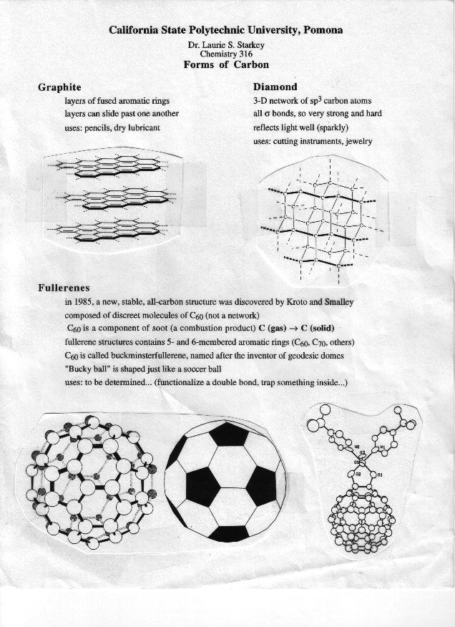
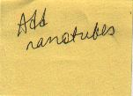
FCPD FLC-Initiated Innovation
Old-school approach
Handout from ~1997
Previous goal: revise handout
Web 2.0 approach
Make a wiki!

Slide 14
Nanotube Wiki: Student Comment
“'Asbestos warning' on nanotubes (By Jonathan Fildes Science and technology reporter, BBC News) As a Biology major, I thought that looking and researching about nanotechnology would be dull and boring. It proved to be really interesting. There are so many wonderful things being written about nanotubes and how they can make a huge impact despite their "nano" size. I was wondering if there were any sort of risks that came along with this new technology. I came across an article that was put out by BBC News about the possible negative effects of nanotubes. The researches compared the molecular structure to that of asbestos, which earlier cause a pandemic of lung disease in the 20th century…. As a bio major, its interesting and exciting to see the worlds of Ochem and Bio clash. Here is the link to the article. I found it really interesting. :)”

Slide 15
Teaching supplements
narrated homework solutions (Flip video, iPhone, Adobe Connect) 3D sketch homework reagent table
iPad app Explain Everything (YouTube videos) cyclohexane
ChemistryConnected channel, created two years ago, has over 70,000 views and over 180 subscribers! Over half the views have come from outside the U.S. (171 different countries) http://www.youtube.com/user/ChemistryConnected
Blackboard skill-building, drill-type quizzes
online lectures at Educator.com (flipped classroom)

Slide 16
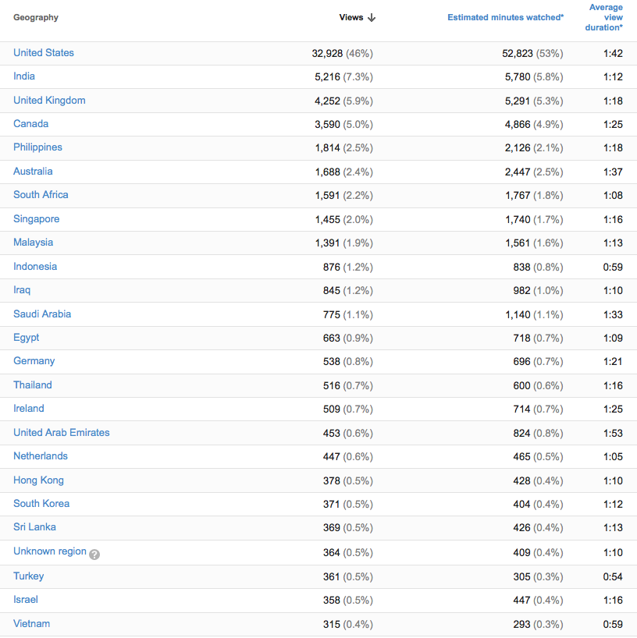
Chemistry Connected YouTube Channel

Slide 17
Reaching out to different learning types
audiovisual presentations blows away text
interactive lessons exercise different "muscles"
addresses visual, auditory AND kinesthetic learners

Slide 18
Tapping into the Affective Domain
How the student feels about the class affects learning! (technology-infused learning can be fun, interesting, engaging, informative, helpful, shiny and new)
How the teacher feels about the class affects teaching! (technology-infused teaching can be fun, interesting, engaging, invigorating, efficient, shiny and new)
Students learn better if they feel the instructor cares about their learning. Students appreciate the effort you put in to support their learning. Does a better attitude about you, about the class, about the subject = better learning? Couldn't hurt!

Slide 19
Acknowledgments
CPP Faculty Center for Professional Development
(ITaL Fellowship, CTL FLC, Clicker FLC, Workshops)
Victoria Bhavsar, Peggy Perry, Carol Holder
eLearning (I&IT), Mediavision
Karen Brzoska April Dawn
Daniel Smith Bo Soh
Erick Zelaya (Flash animations)
Terry Hogan, Trevor Henderson (video production)
ADVANCE Program
Barbara Hacker (iPad FLC)
Thanks to Provost’s Award Committee
Thank YOU!

